Slide 1
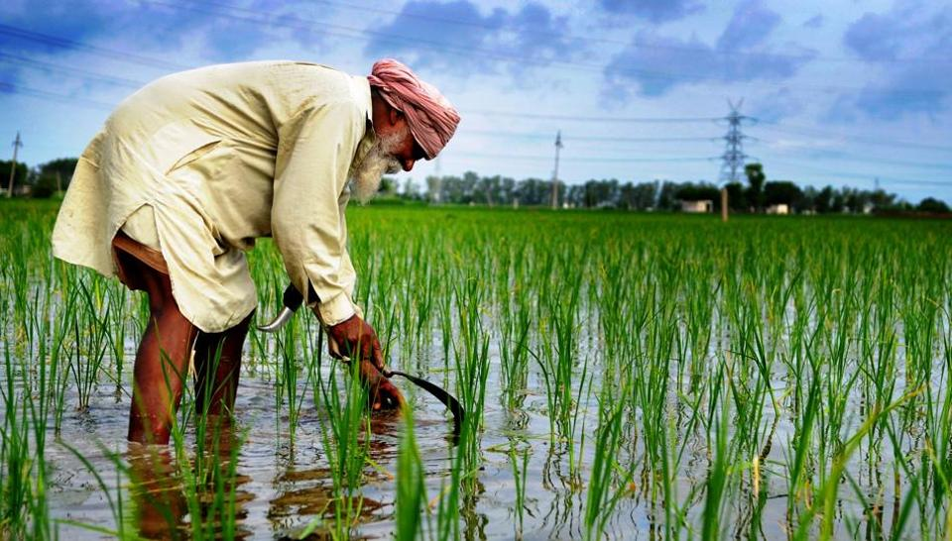
The Cost of Green Revolution
Case Study - 4
Source: hindustantimes.com
Notes:
Reading material for these slides:
Case study 10, page number 70, in the environmental reader textbook
https://www.thehindubusinessline.com/opinion/the-paradox-of-indias-green-revolution/article27472671.ece
https://www.kalw.org/post/pattern-farmer-suicides-punjab-unearthing-green-revolution#stream/0
https://www.npr.org/templates/story/story.php?storyId=102893816
https://www.npr.org/2009/04/14/102944731/green-revolution-trapping-indias-farmers-in-debt
http://livingheritage.org/green-revolution.htm
Prepared by: Shaurya Rahul Narlanka

Slide 2
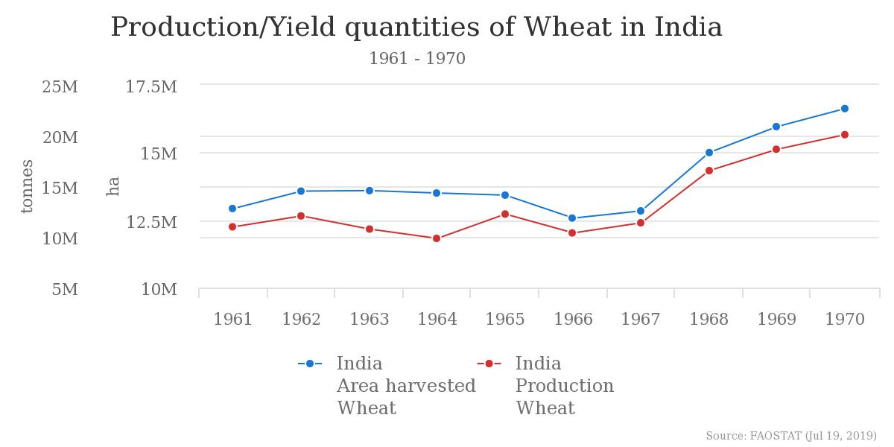
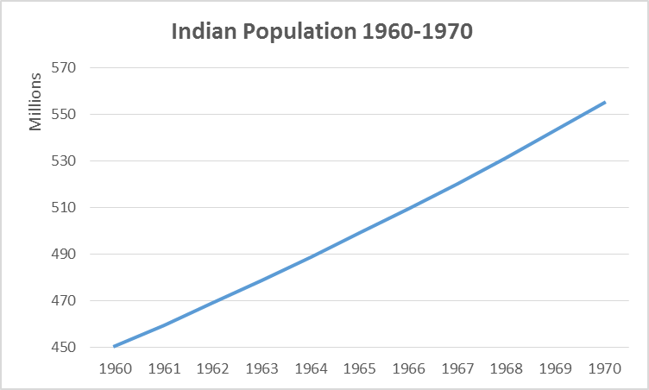
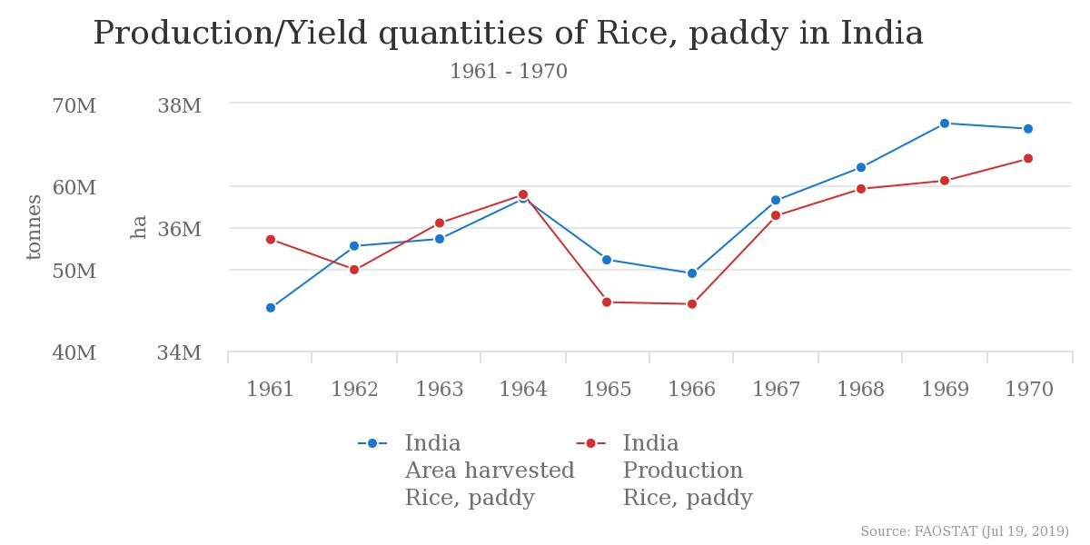
India’s Food Security Scenario 1960-1970
Source: World Bank
Notes:
India, historically, has always been known to be a country of famines. Towards the end of the colonial rule in the country, agriculture had seen stagnant or negative growth rates which partly contributed to The Bengal Famine of 1943, leaving parts of the country devastated. Post independence, India did try to boost agricultural productivity but it frequently fell below the requirements of the steadily growing nation (Refer to graph on the right) which forced it to import grains. This was a huge burden on the coffers of an already impoverished country. Furthermore, successive droughts such as those in the years 1966-67 (highlighted in the graphs on the left) severely compromised the country’s food security causing a famine in some areas, whose effects were only reduced due to international intervention. As a result, it was quickly becoming imperative for India to strengthen its agriculture to improve its self-sufficiency/sovereignty, economy, food security and the general well-being of its citizens. That is why in the 1960s and 1970s, Government of India introduced a string of policies which included introduction of high-yield variety (HYV) seeds, irrigation facilities, pesticides, fertilizers and land consolidation for agriculture. Together, these policies culminated as what we now call as the “green revolution” in India. Punjab was the first state to be subjected to these policies by receiving HYV dwarf wheat seeds imported from Mexico because it was more water secure than the rest of the country and had a successful agricultural history.

Slide 3
India, historically, has always been known to be a country of famines. Towards the end of the colonial rule in the country, agriculture had seen stagnant or negative growth rates which partly contributed to The Bengal Famine of 1943, leaving parts of the country devastated.
Post independence, India did try to boost agricultural productivity but it frequently fell below the requirements of the steadily growing nation (Refer to graph on the right) which forced it to import grains. This was a huge burden on the coffers of an already impoverished country. Furthermore, successive droughts such as those in the years 1966-67 (highlighted in the graphs on the left) severely compromised the country’s food security causing a famine in some areas, whose effects were only reduced due to international intervention.
Note : 1 hectare = 2.471 acre

Slide 4
As a result, it was quickly becoming imperative for India to strengthen its agriculture to improve its self-sufficiency/sovereignty, economy, food security and the general well-being of its citizens. That is why in the 1960s and 1970s, Government of India introduced a string of policies which included introduction of high-yield variety (HYV) seeds, irrigation facilities, pesticides, fertilizers and land consolidation for agriculture.
Together, these policies culminated as what we now call as the “green revolution” in India. Punjab was the first state to be subjected to these policies by receiving HYV dwarf wheat seeds imported from Mexico because it was more water secure than the rest of the country and had a successful agricultural history.

Slide 5
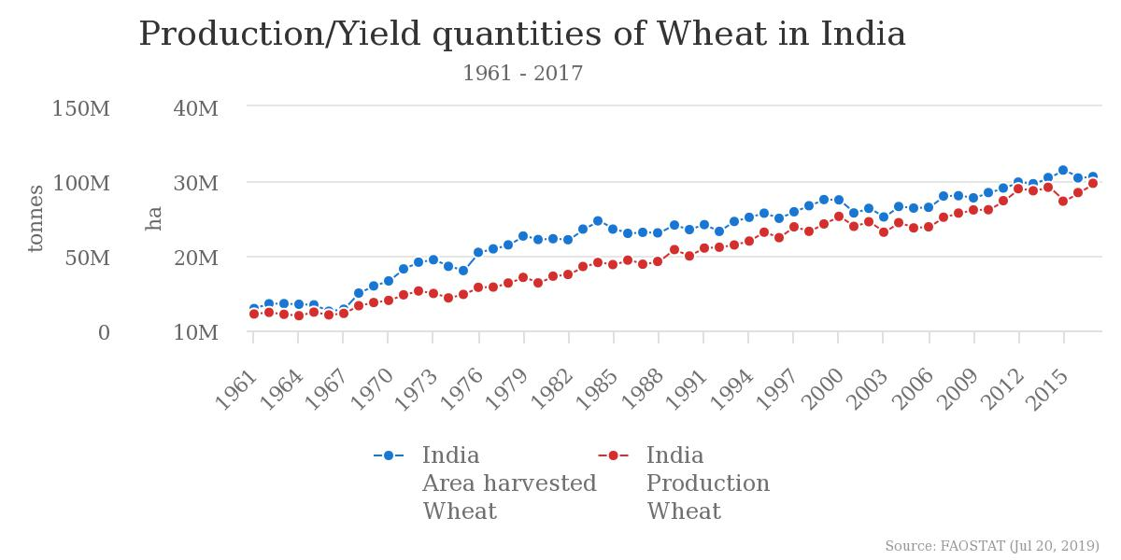
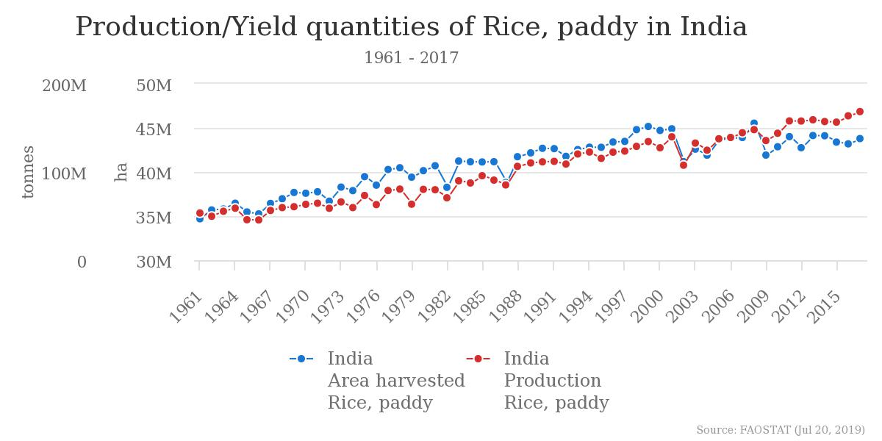
The Indian Green Revolution
Notes:
As a result of those policies, India’s agricultural production shot up to the point that it became food self-sufficient and was even able to start exporting its agricultural produce. The graphs in the slide show the scale of boost. Rice production rose almost 3 times and Wheat production rose almost 10 times in the period 1960-2015.
Source for the graphs: http://www.fao.org/faostat/en/#data/QC

Slide 6
As a result of those policies, India’s agricultural production shot up to the point that it became food self-sufficient and was even able to start exporting its agricultural produce. The graphs in the slide show the scale of boost. Rice production rose almost 3 times and Wheat production rose almost 10 times in the period 1960-2015.

Slide 7
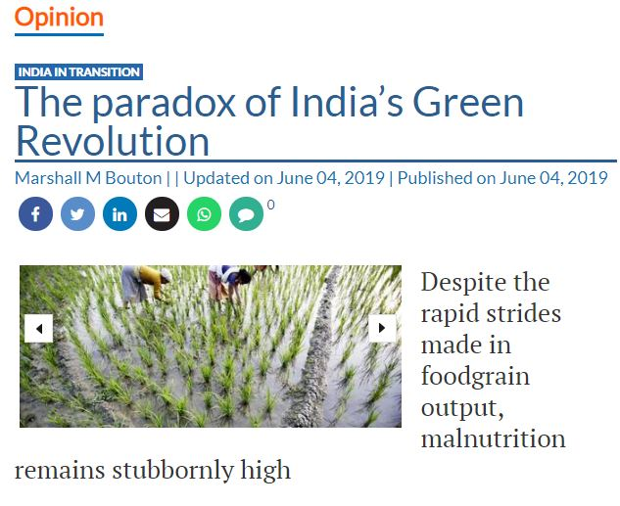
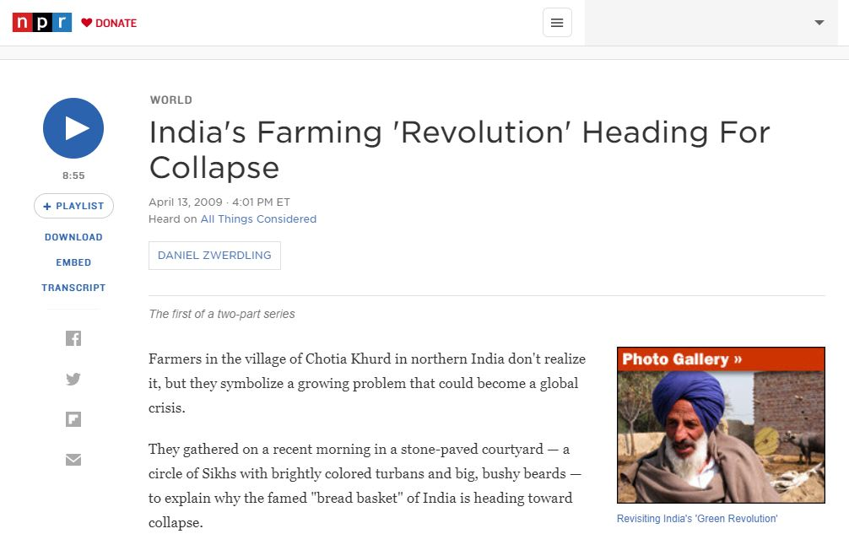
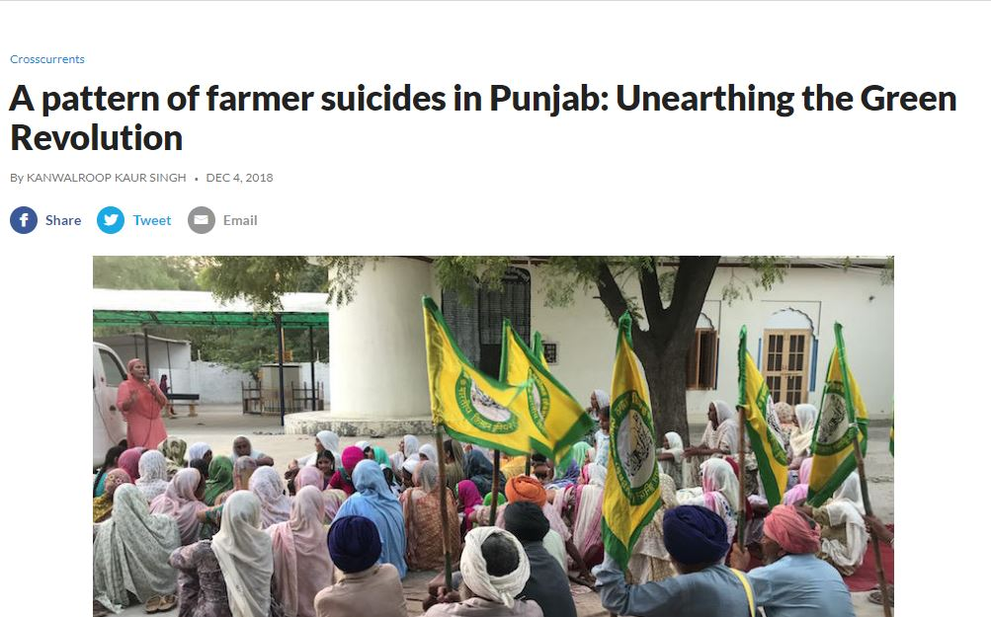

The Flipside
Source: Hindu Businessline
Source: kalw.org
Notes:
Though the green revolution yielded great short term benefits for India, it is now posing some serious long term consequences. Heavy pesticide and fertilize use coupled with resource intense crops have deteriorated the micronutrient content of soil in Punjab. Heavy dependence on irrigation from borewells coupled with weak monsoons has severely depleted the underground aquifers, forcing the farmers to dig deeper borewells than ever before. Unfortunately, deeper borewell waters are also more saline and cause damage to crop roots and the soil, further decreasing their productivity. Beyond this, the heavy pesticide and fertilizer use have had some serious health consequences for the farmers and intensification of irrigation and machine farming has increased their debt causing a sharp rise in drug use and their suicide rates.

Slide 8
Though the green revolution yielded great short term benefits for India, it is now posing some serious long term consequences. Heavy pesticide and fertilize use coupled with resource intense crops have deteriorated the micronutrient content of soil in Punjab.
Heavy dependence on irrigation from borewells coupled with weak monsoons has severely depleted the underground aquifers, forcing the farmers to dig deeper borewells than ever before. Unfortunately, deeper borewell waters are also more saline and cause damage to crop roots and the soil, further decreasing their productivity.
Beyond this, the heavy pesticide and fertilizer use have had some serious health consequences for the farmers and intensification of irrigation and machine farming has increased their debt causing a sharp rise in drug use and their suicide rates.

Slide 9
Solutions?
Refocus on ecologically sensitive agriculture
Reintroduction of native seeds to maintain genetic diversity of seeds
Shifting from mono-cropping to multi-cropping system to better regulate the nutritional content of soil
More effective water management programs to ensure better water and moisture conservation
Introduction of crop insurance schemes to better protect the farmers

